Slide 1
Learn how to build a great experiential moment and make money at it
Phil Chang and Kenny Vannucci

Slide 2


About us
Phil is fixated with digital marketing. He’s got a mix of sales, marketing in packaged goods, Phil helps companies with branding, content marketing and digital presence.
He’s the co-host of This Commerce Life, and founder of retailPhil. Phil is also teaching A Marketing Plan - Not Just Social Media
Twitter: @retailphil
Kenny is a tattooed retail wonder. A former retailer for almost 30 years, Kenny now blows up companies. Companies that go to Kenny go through an analytic grinder and come out healthier and poised for growth.
He’s the co-host of This Commerce Life, and founder of Cardan Marketing. Kenny is also teaching 80/20 Rule: Optimize Your SKU Lineup and Put Money Back to Work for You
Twitter: @kootenayborn

Slide 3
Everyone is talking about experiential marketing. In this session, start with your in-store (virtual or brick and mortar) experiential opportunities and learn how to build it with return on investment in mind. Surprise and delight for the consumer doesn’t mean losing money for you the retailer. Learn how to build a great experiential moment and make money at it.

Slide 4
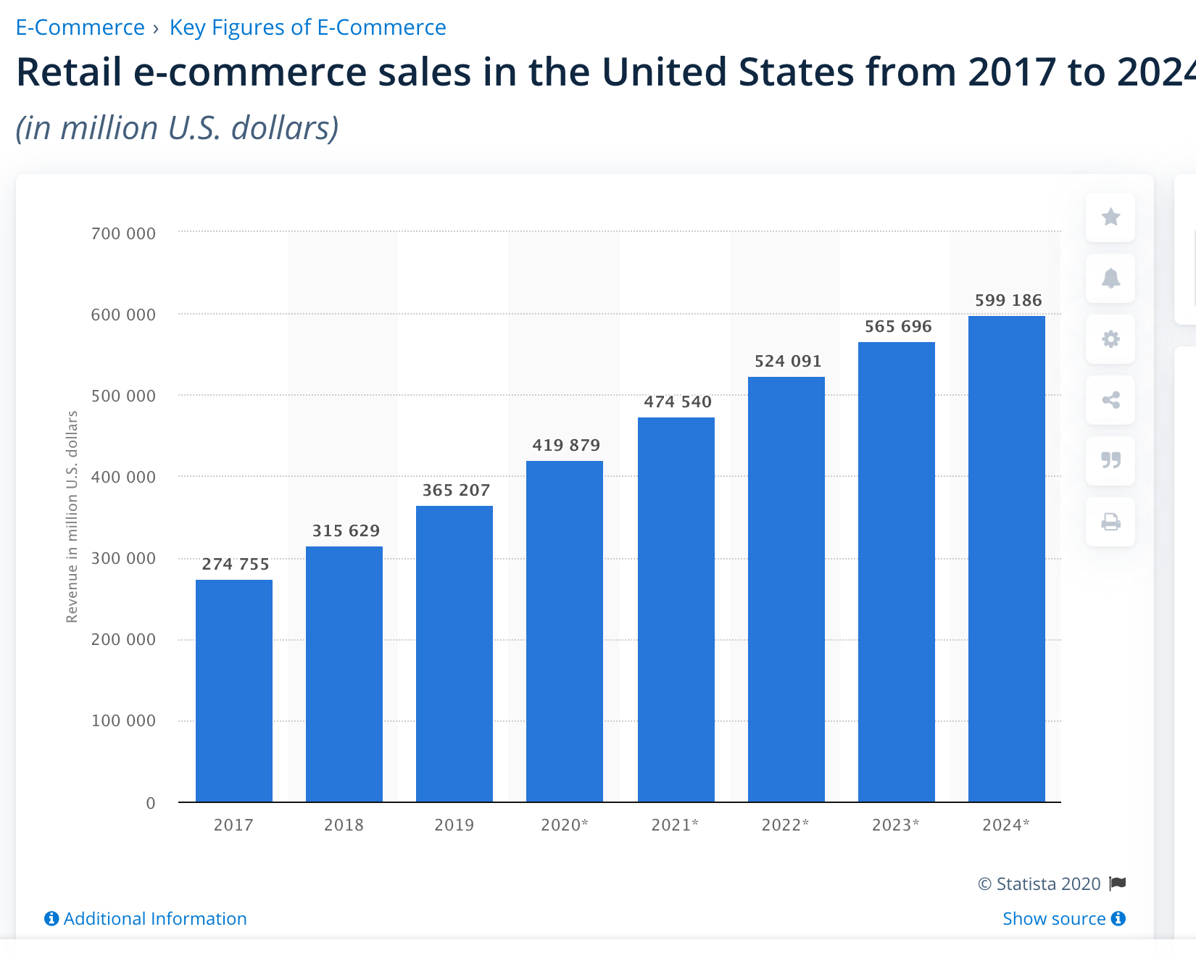
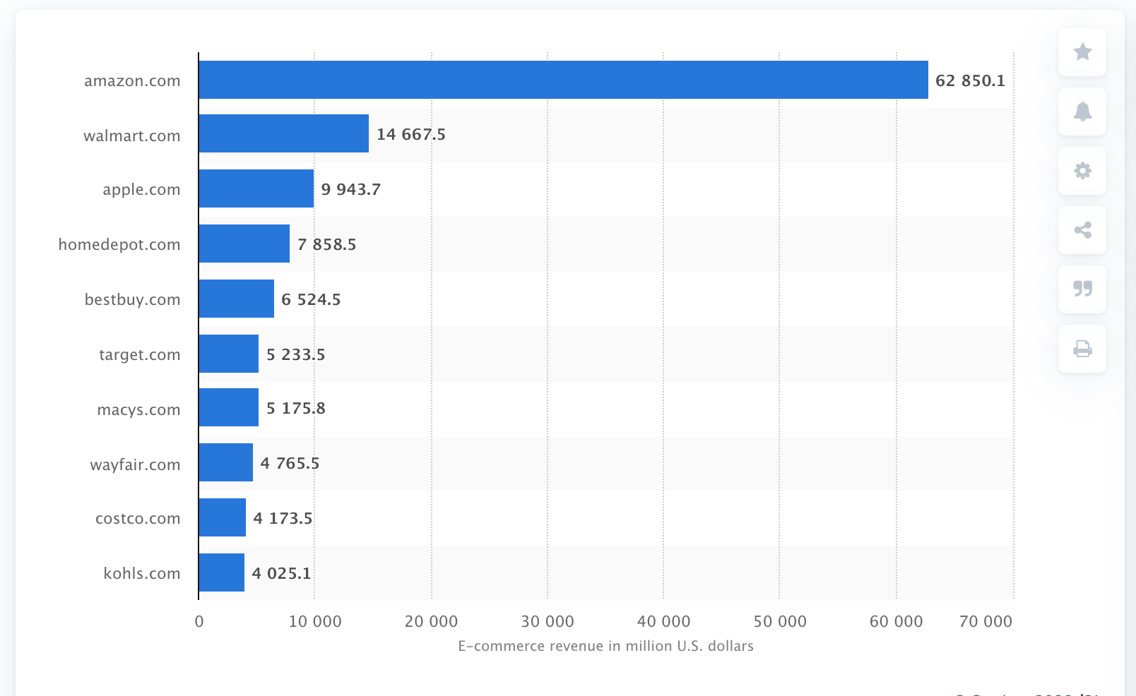
Online grows every month, but the significance of online still lags Bricks & Mortar
The shopping trip for the consumer is changing. Whether we like it or not, online is taking a significant portion of sales from bricks and mortar.

Slide 5
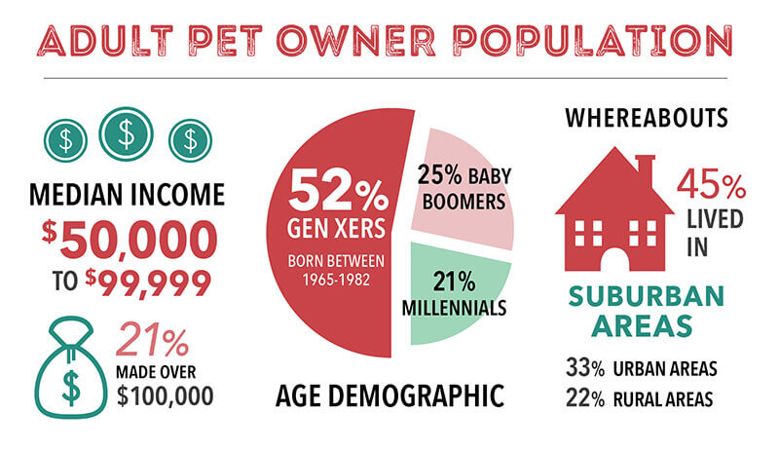
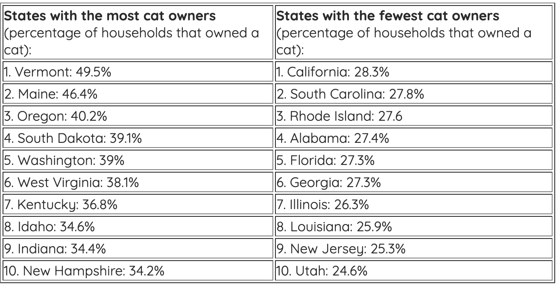
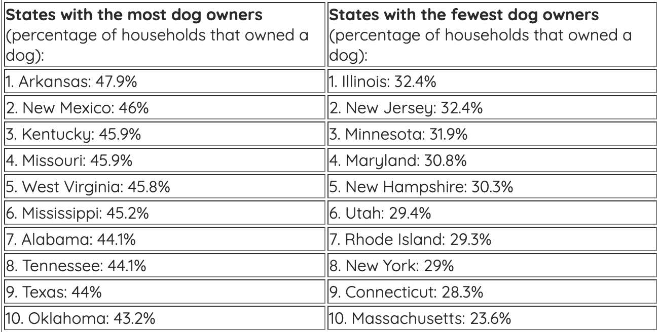
Relevant Pet Numbers
66% of US households have pets. (APPA Est)
The ratio of Dogs to Cats in US is 5:4 (Economist)
Estimated that there are 140MM Freshwater Fish as Pets in US (Statista)
Americans Spent $70B on their pets in 2019 (APPA Est) with over 40% being Pet Food.
Common reason to have a pet is assist against depression and loneliness.

Slide 6
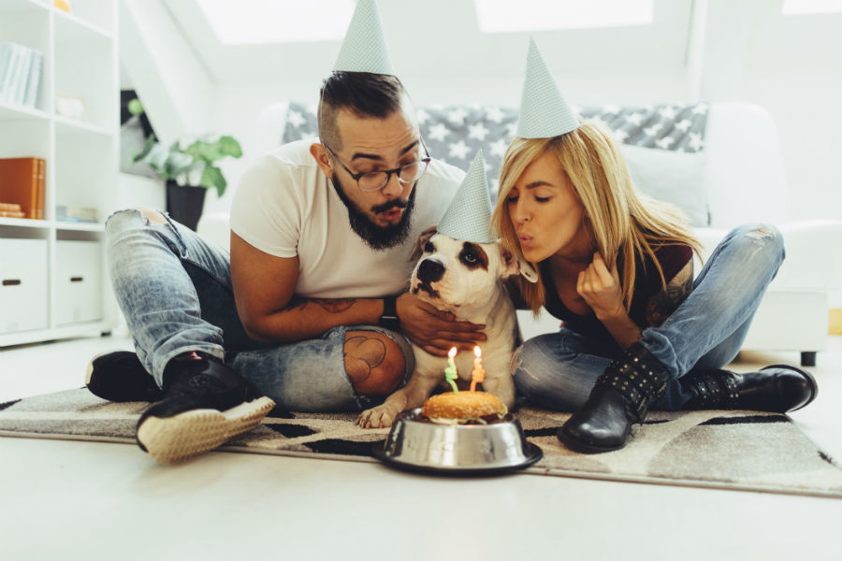
The Millennial! A ZuLily Survey – Forbes Oct 18, 2018
35% of pet owners are now millennials as compared with 32% of boomers.
42% of millennial pet owners said, if given a choice, they would rather snuggle up with their pets than their romantic partner.
82% of millennials view pet parenting as preparation for having a baby.
80% of millennials say they frequently worry about their pets when they are apart even when running short errands, 70% would be willing to take a pay cut if they could bring their pet to work every day and 65% say being separated from their pet for a week would be worse that doing without their cell phones.
More than half (51%) of millennials buy gifts for their pets once a month or more and 60% of millennials saying they are likely to buy sweaters, coats, dresses and other fashion for their pets.
63% find expertise is lacking in the big-box pet stores, grocery stores and mass retailers.
They up to foods that match their own dietary trends, including premium and less processed pet food and they will do this with all other categories as well…

Slide 7
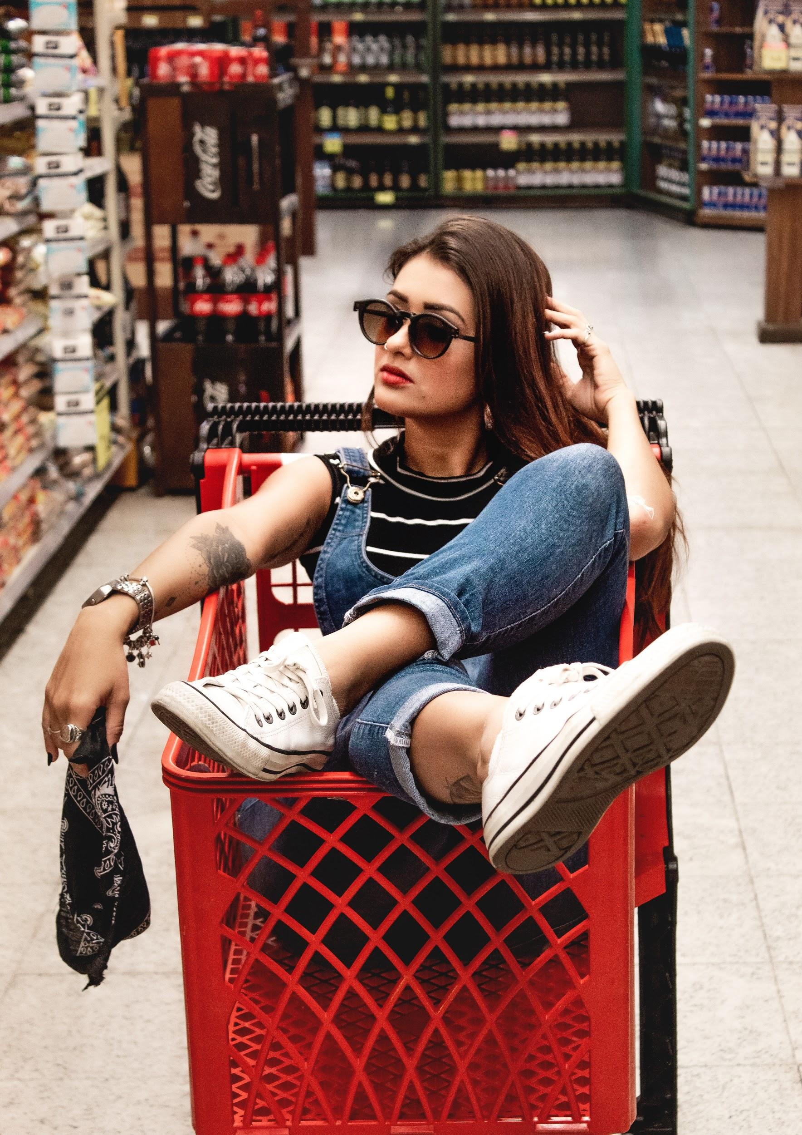
What hasn’t changed? The consumer wants to have great retail moments, regardless of online/in store.
Notes:
Winning at this allows you to have great moments and make money. [need to flesh this out a little more IMO]

Slide 8
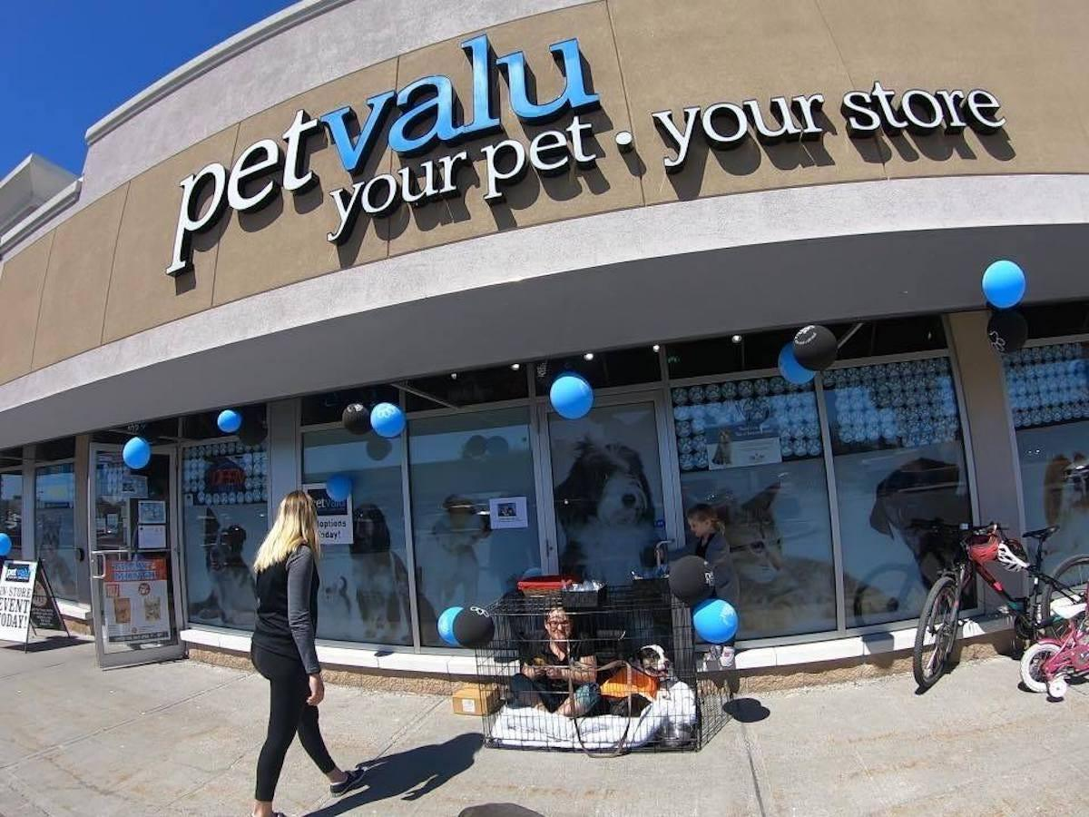
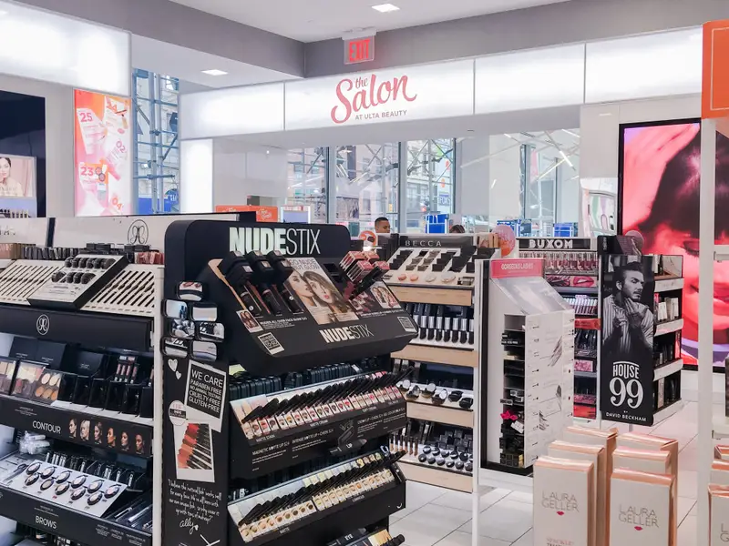
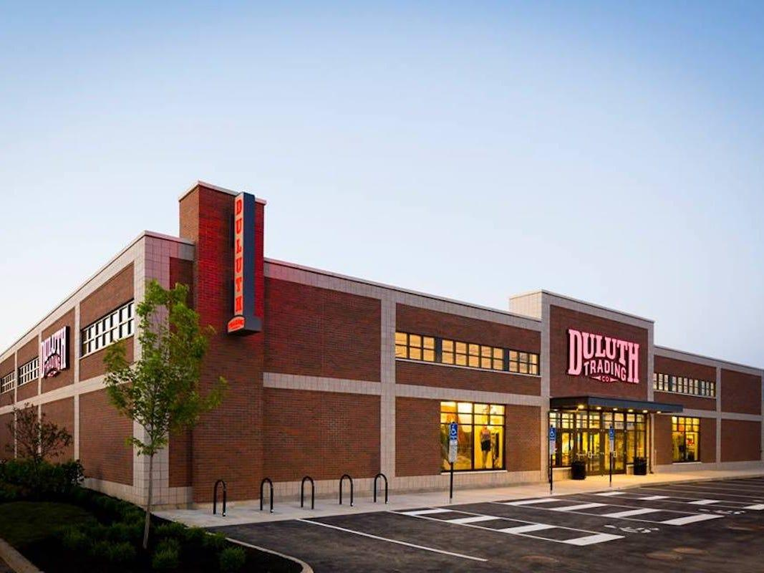
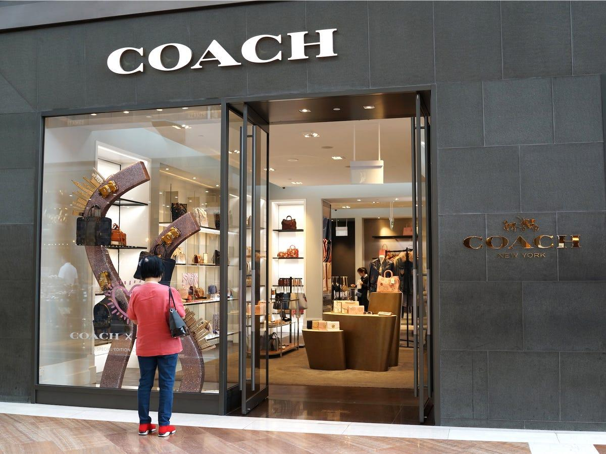
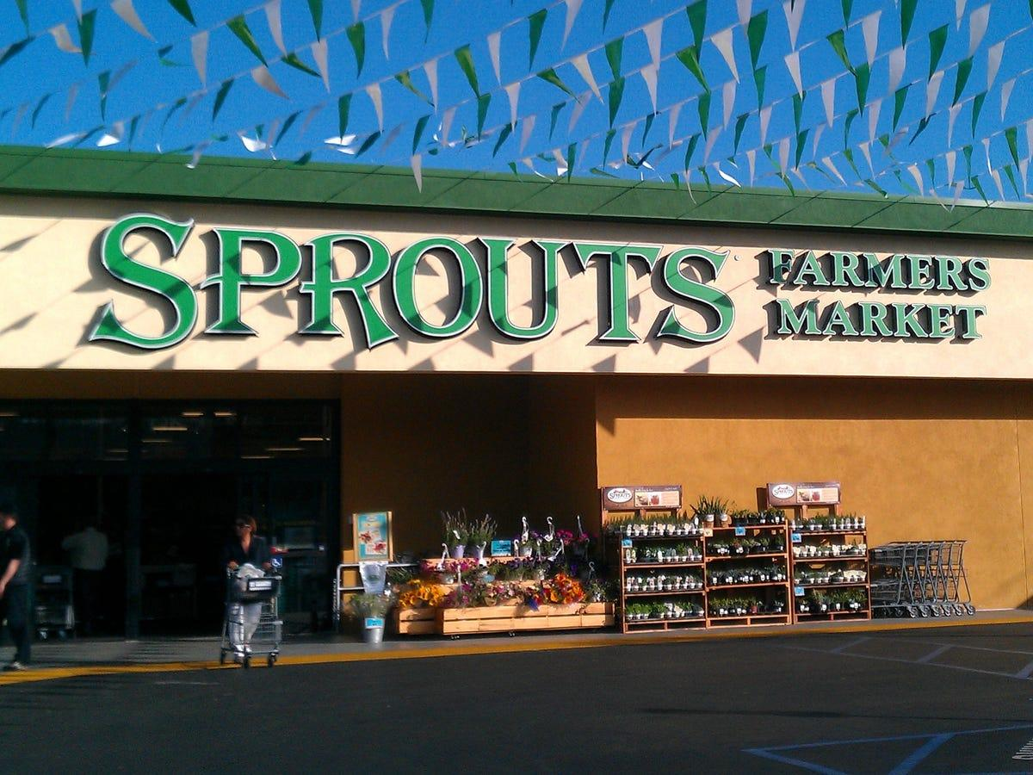
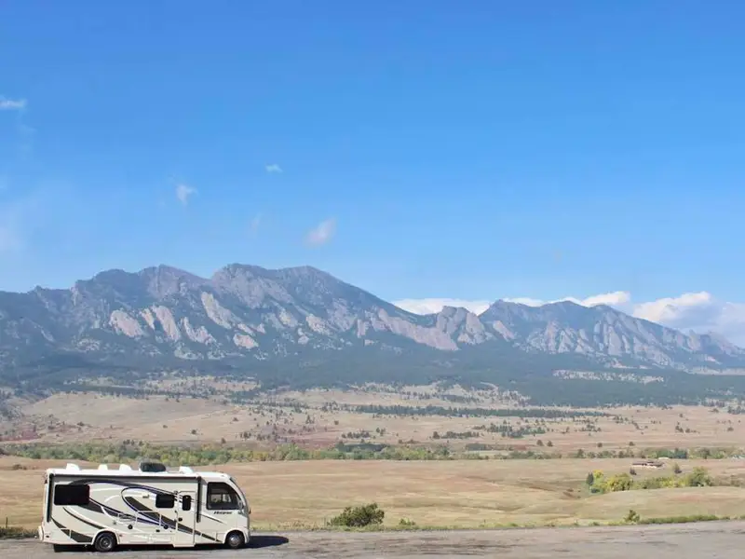
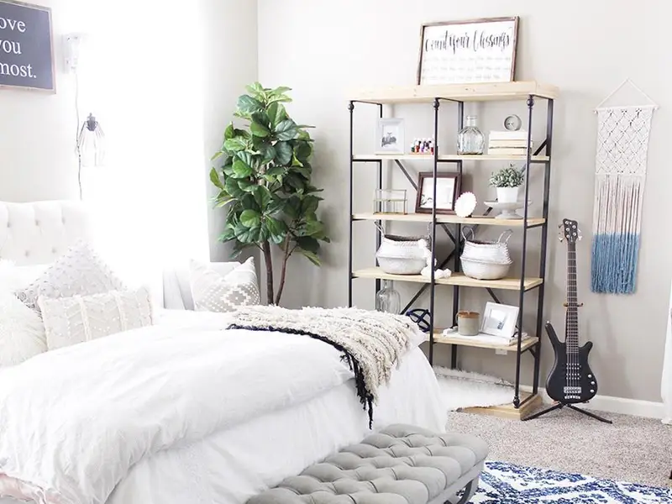

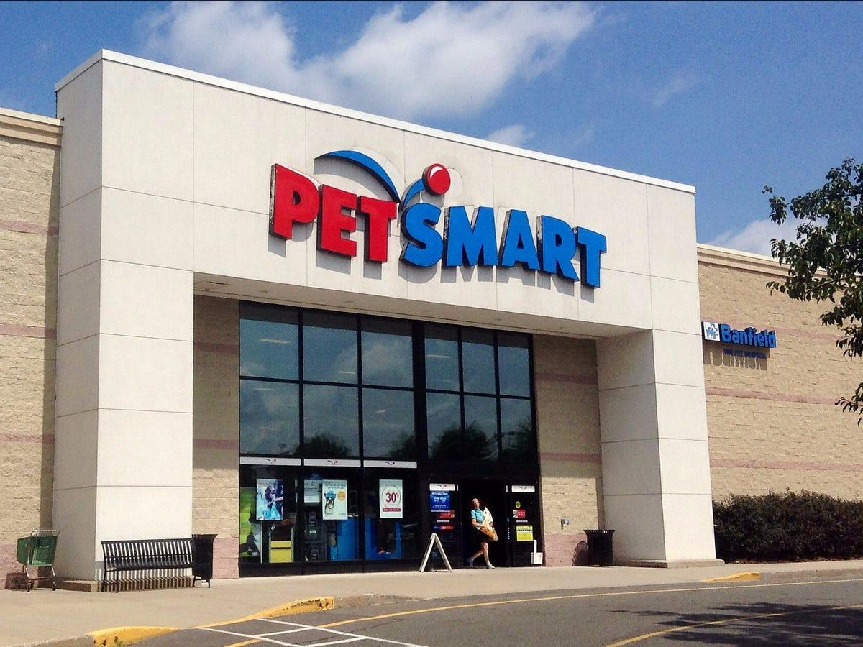
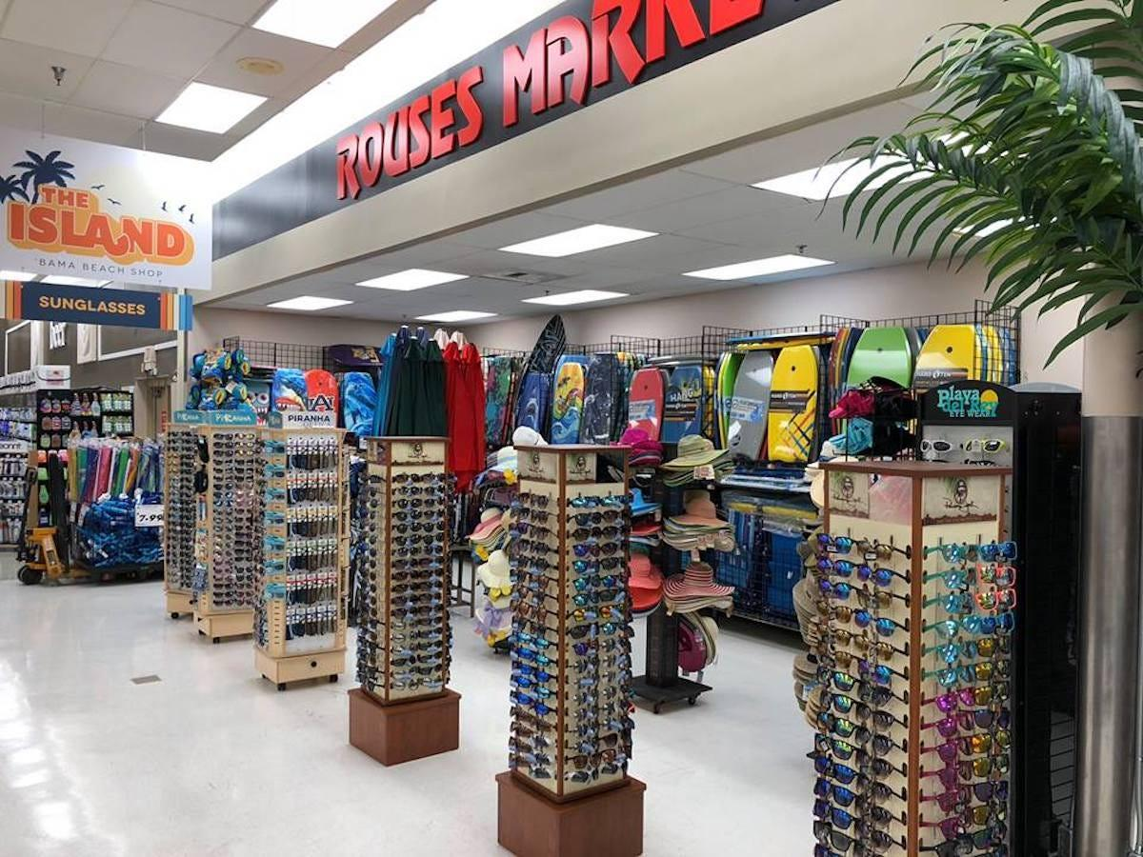
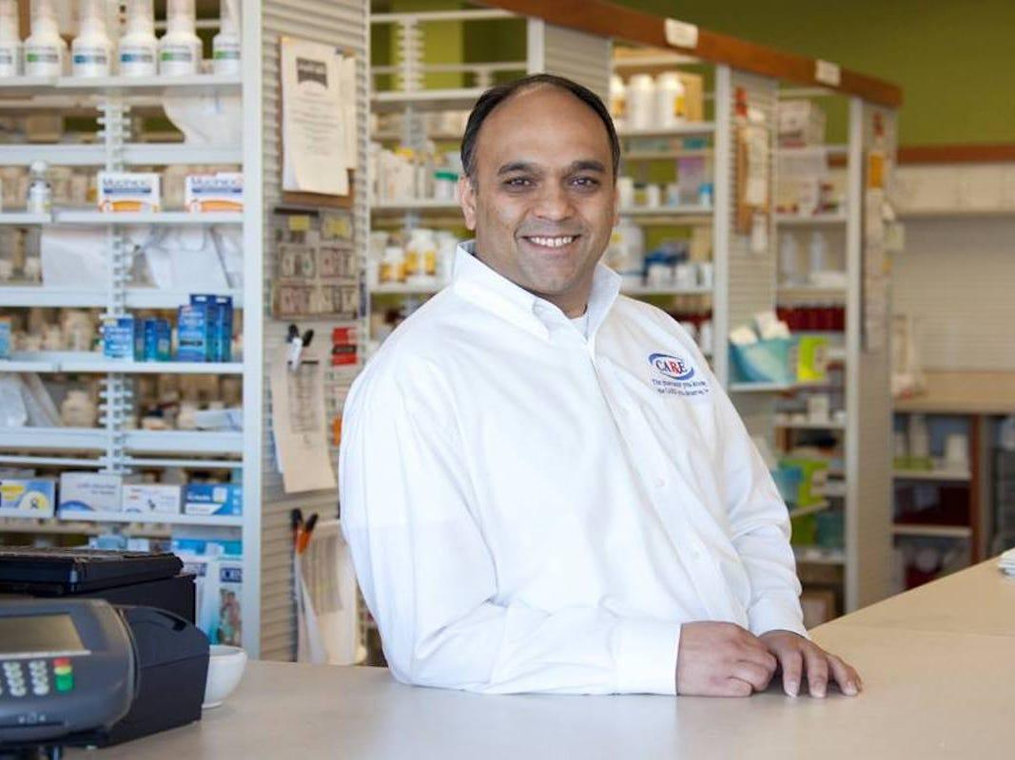
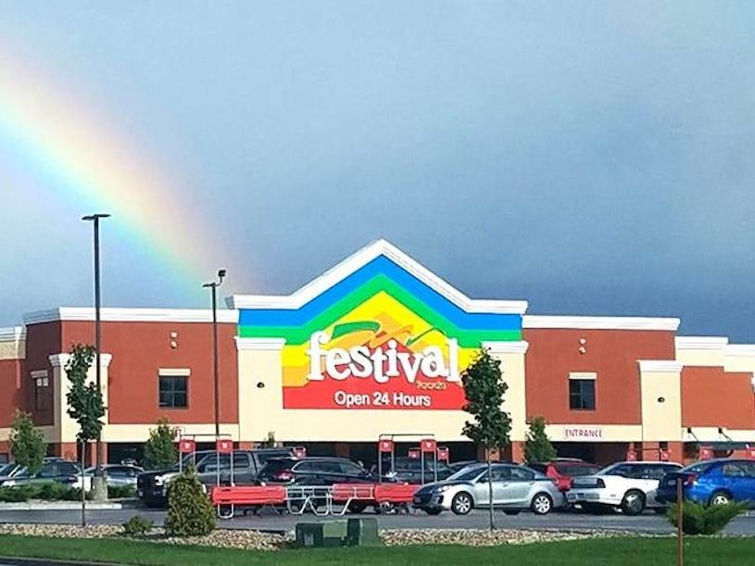
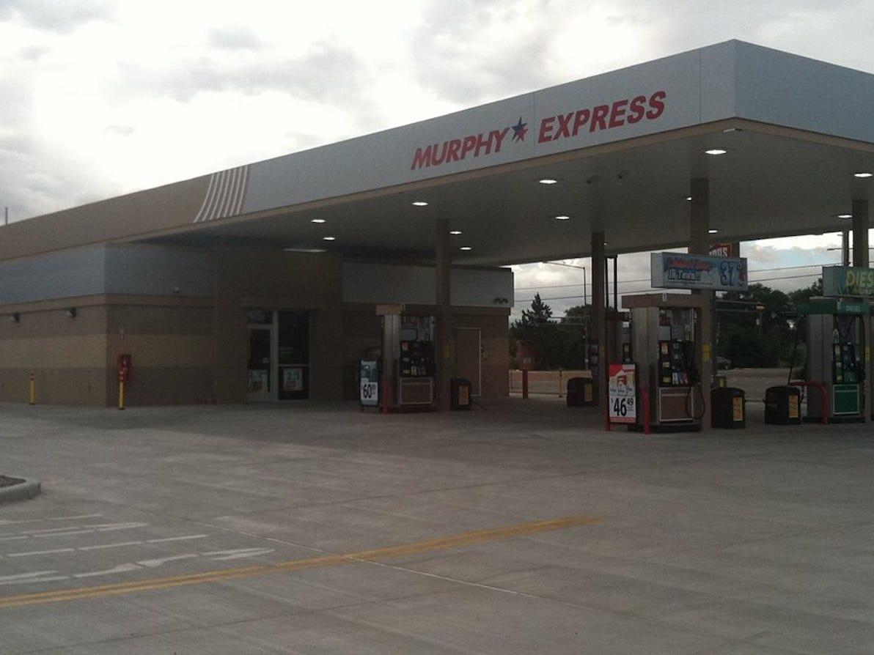
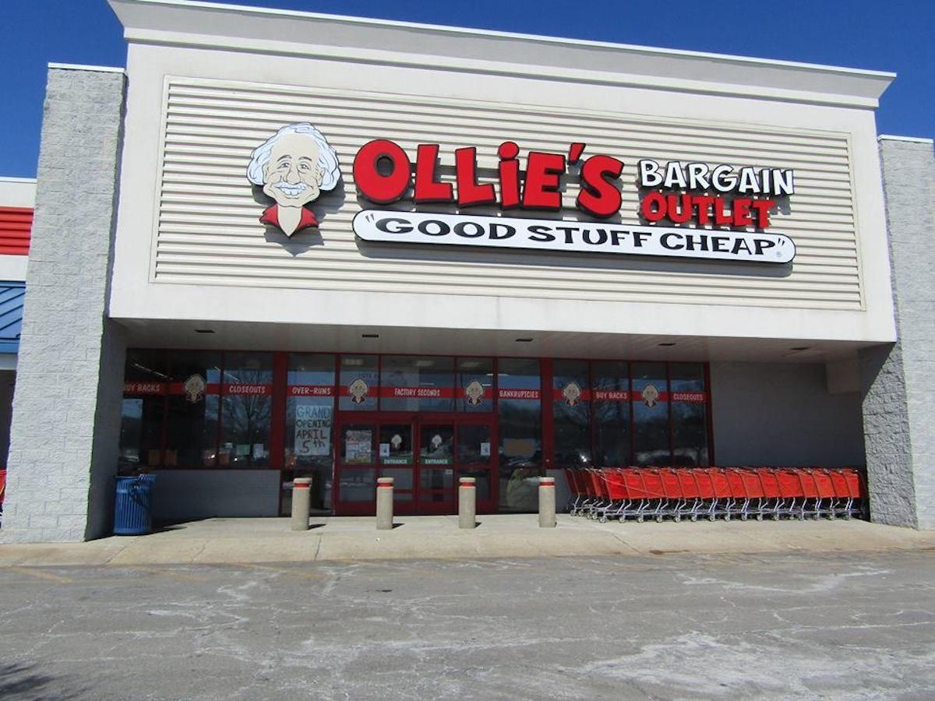
Not sure if this is true? Let’s look at real life examples
Differentiated
Inexpensive
Expensive
Commodity
https://www.businessinsider.com/fastest-growing-retailers-in-america-2018-8?op=1#7-petsmart-8647-billion-in-sales-up-28-year-over-year-14
Notes:
Not done with this slide. overlay quads for growth.

Slide 9
Social trends that matter

Slide 10
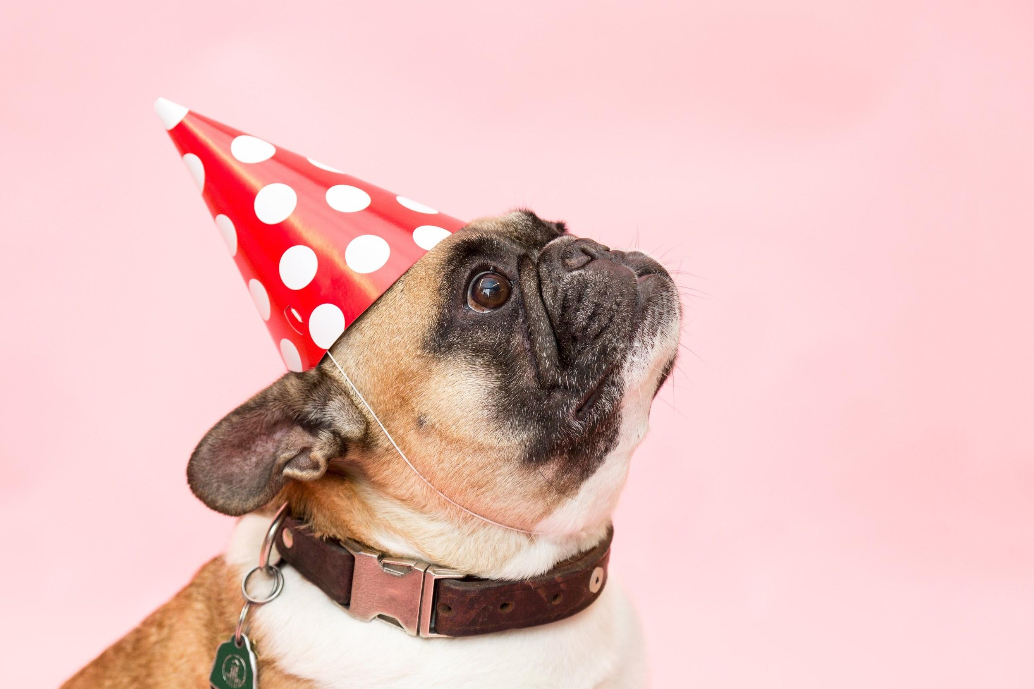
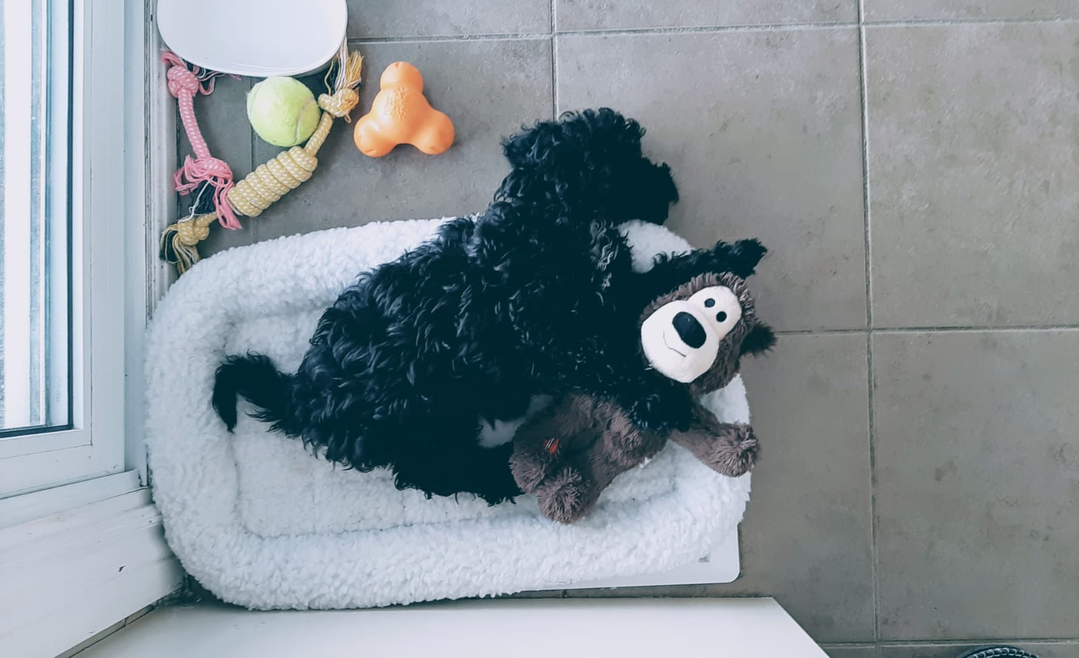
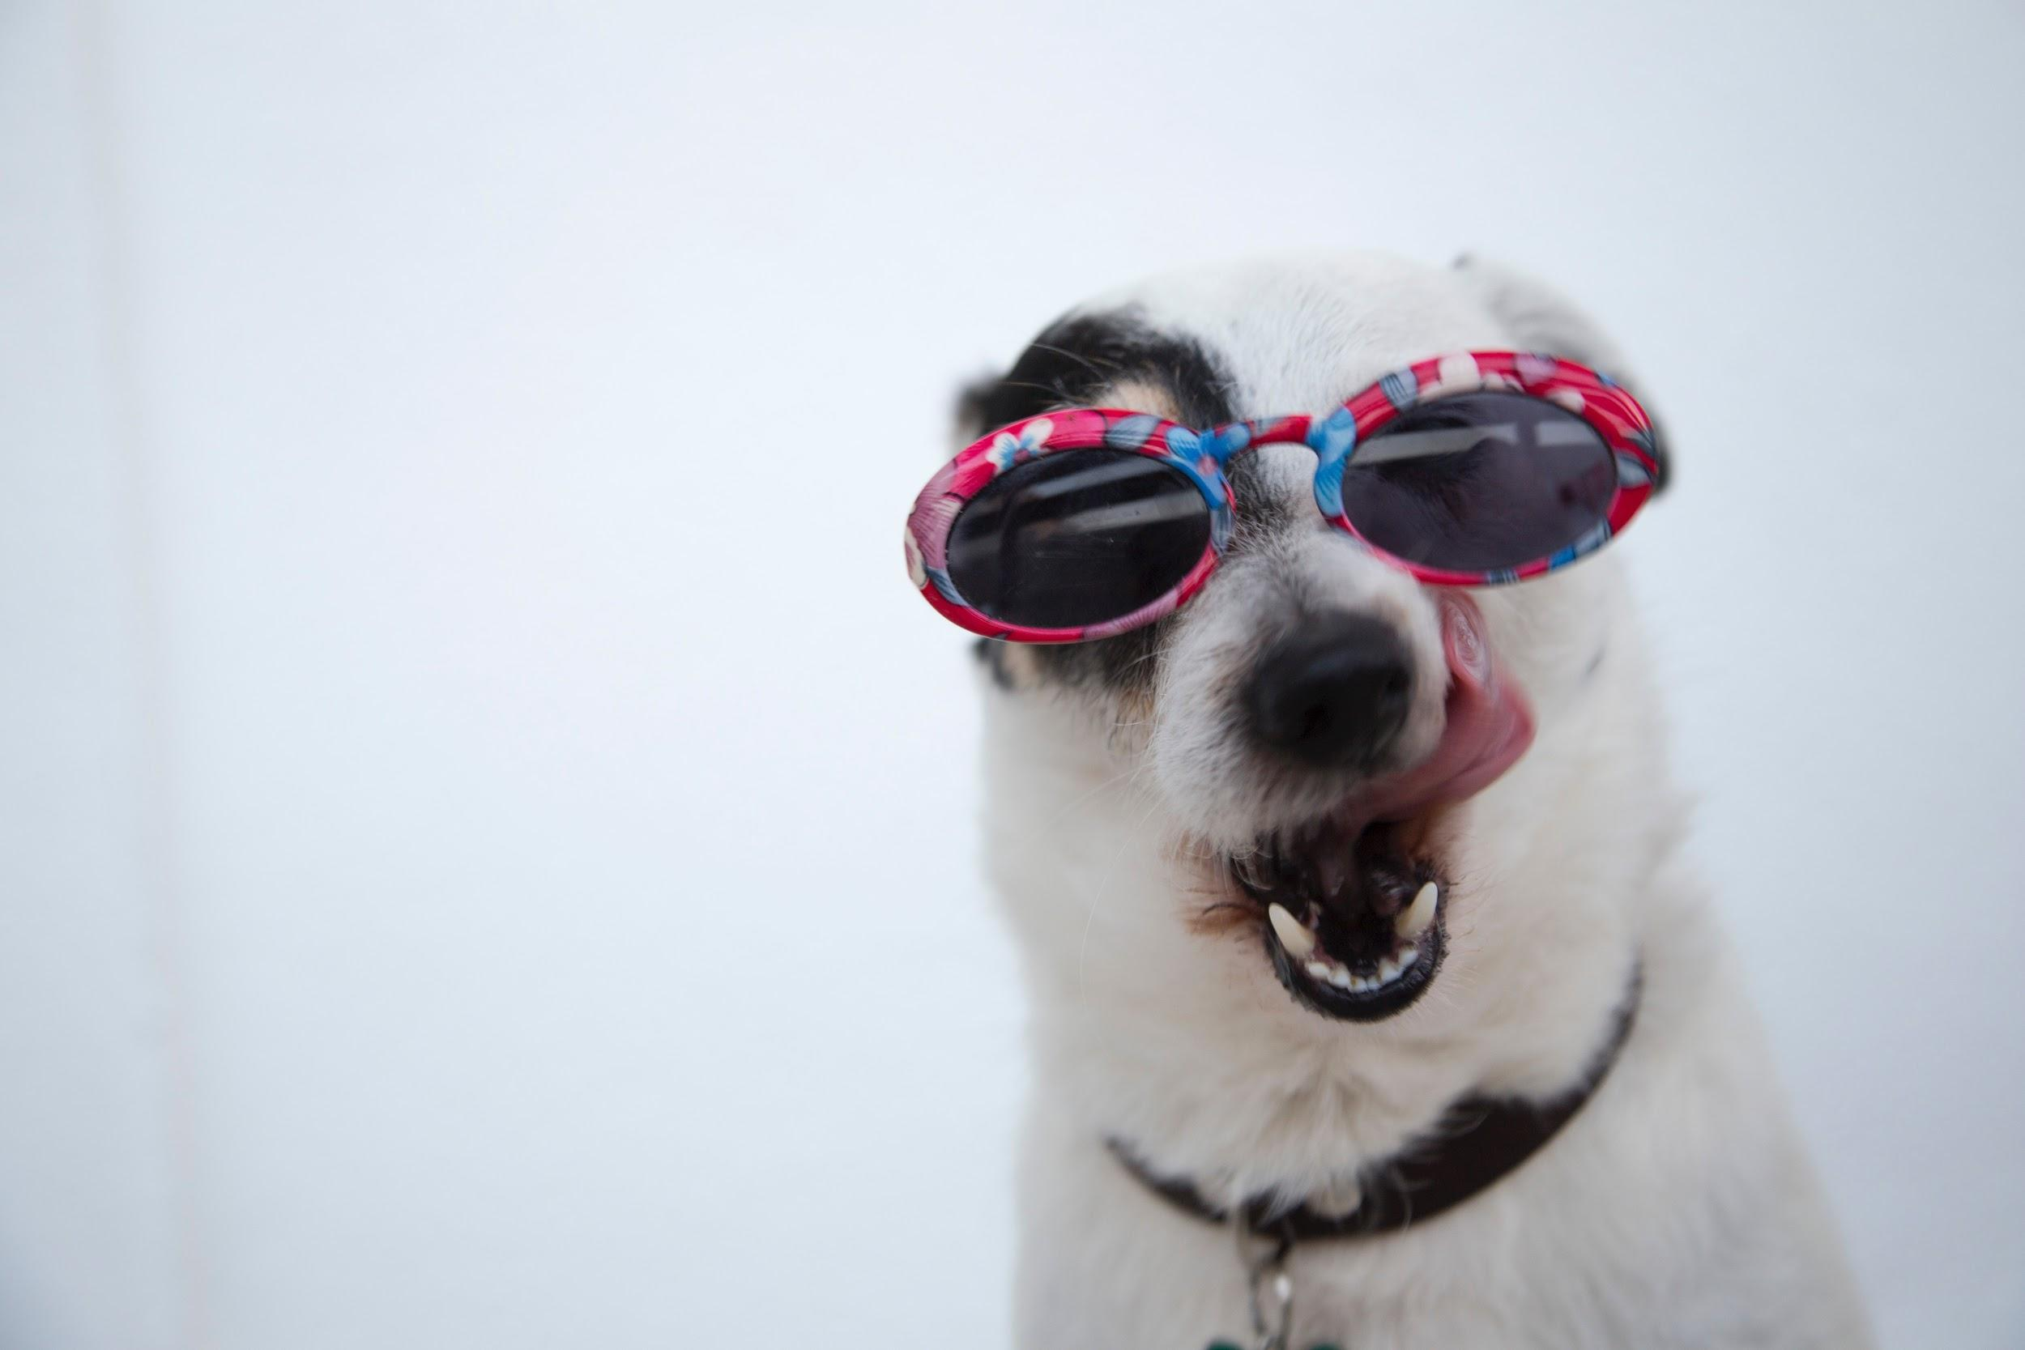
Pet are people too. Experiential moments headline top growth moments
Of the 12 fastest growing categories in Pet, 7 are experiential services or products for either the
Holistic cat and dog food
Cat litter
Natural flea and tick repellents
Toys made with natural fibers
Pet behavioral consulting
Pet portrait photography
Pet-friendly travel
Mobile pet Grooming
Pet sitting
Holistic grooming products such as the blueberry facial for dogs
Products for older pets, particularly for dogs
Upscale and holistic spa services such as “paw-tinctures,” Reiki and pet massage
https://www.thebalancecareers.com/hot-industry-trends-in-pet-businesses-2660622

Slide 11
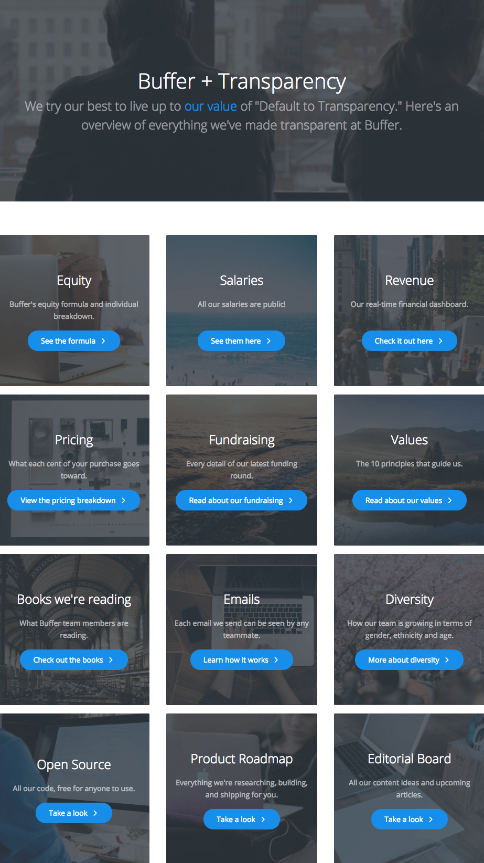
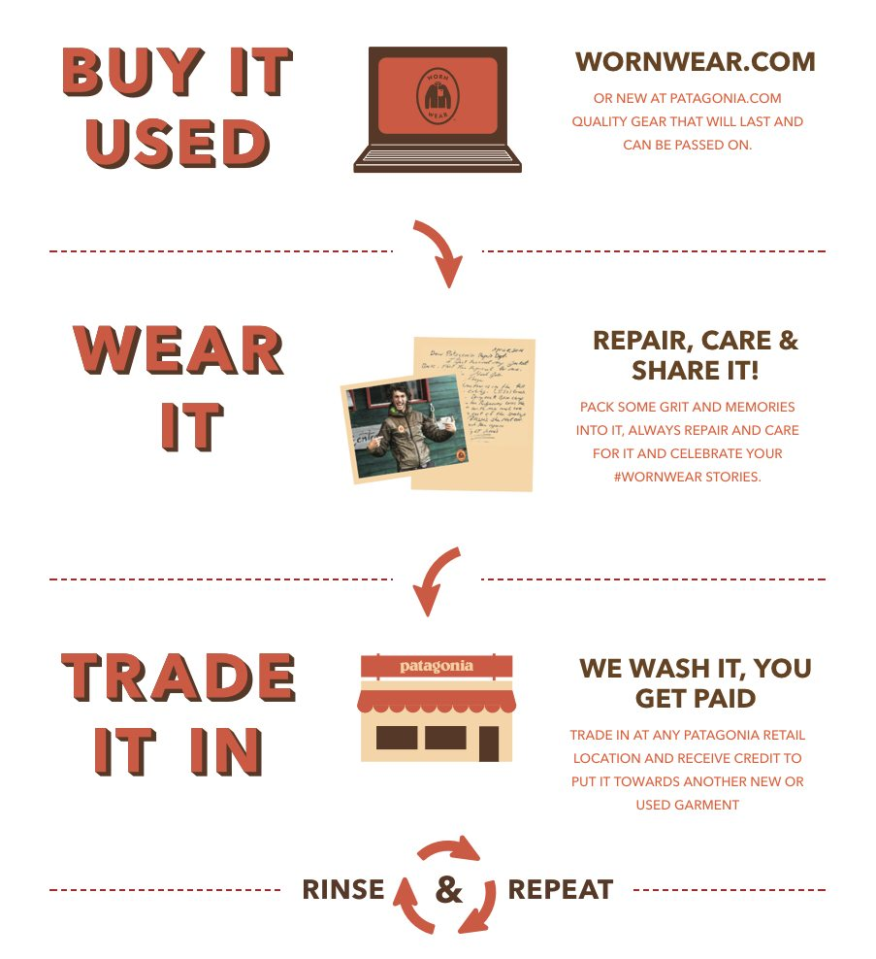
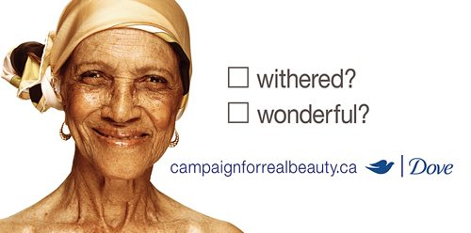
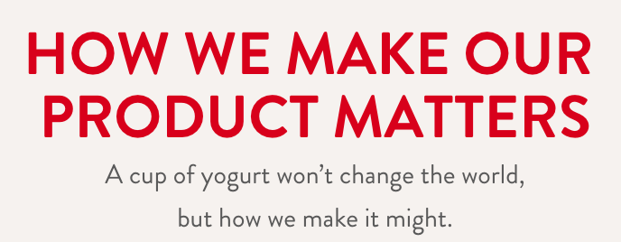
Authenticity over advertising
only 33% of shoppers trust advertising and information that directly comes from a brand, and only 29% of shoppers would let an influencer… well, influence their purchase
https://www.mobilemarketer.com/news/social-media-users-trust-fellow-consumers-more-than-brands-study-finds/552994/

Slide 12
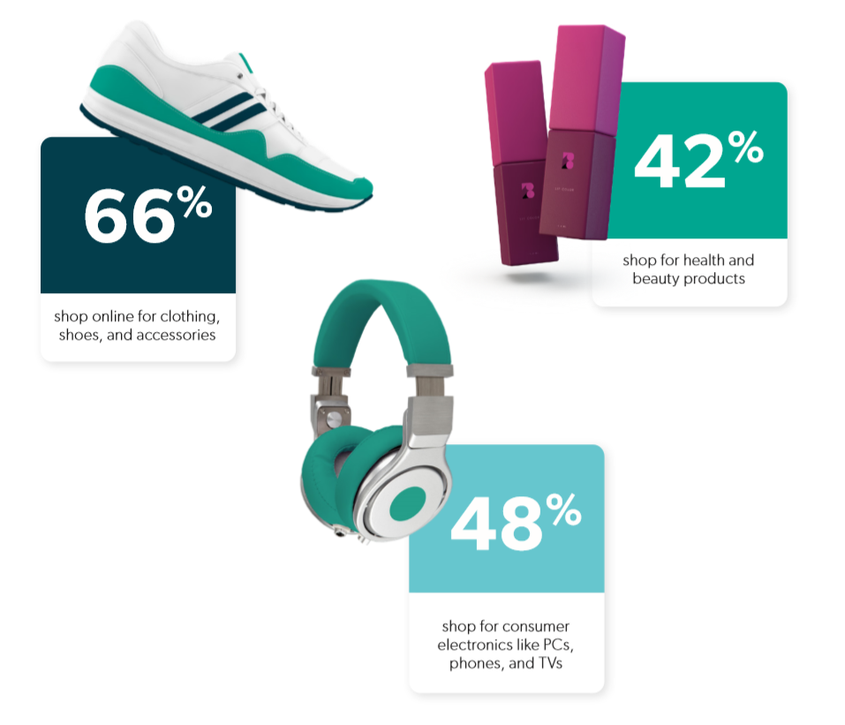
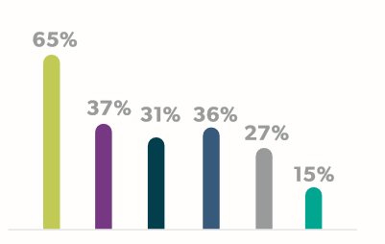
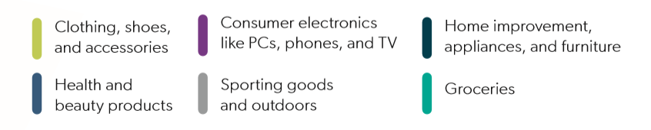
Online shopping has shifted how the consumer thinks of their shop
62% of survey respondents say they shop online every month, with 21% shopping online more than once every week, demonstrating the growth taking place in online shopping
Notes:
the majority of brand advertising budgets are dedicated to paid search (Google, Bing, Yahoo), a.k.a. pay-per-click (PPC). Roughly 40% is used for paid search, while less than 20% is dedicated each to paid social, display, and YouTube, and under 10% is dedicated each to in-app, Amazon, and general e-commerce12. Data shows that when product searches originate on Google, shoppers are quicker to buy than when the search begins on any other site. (this needs some refinement) - maybe “the journey starts online?”
online=commodity items,
BOPUS=household staples,
in-store=unique and seeking answers/exploration

Slide 13
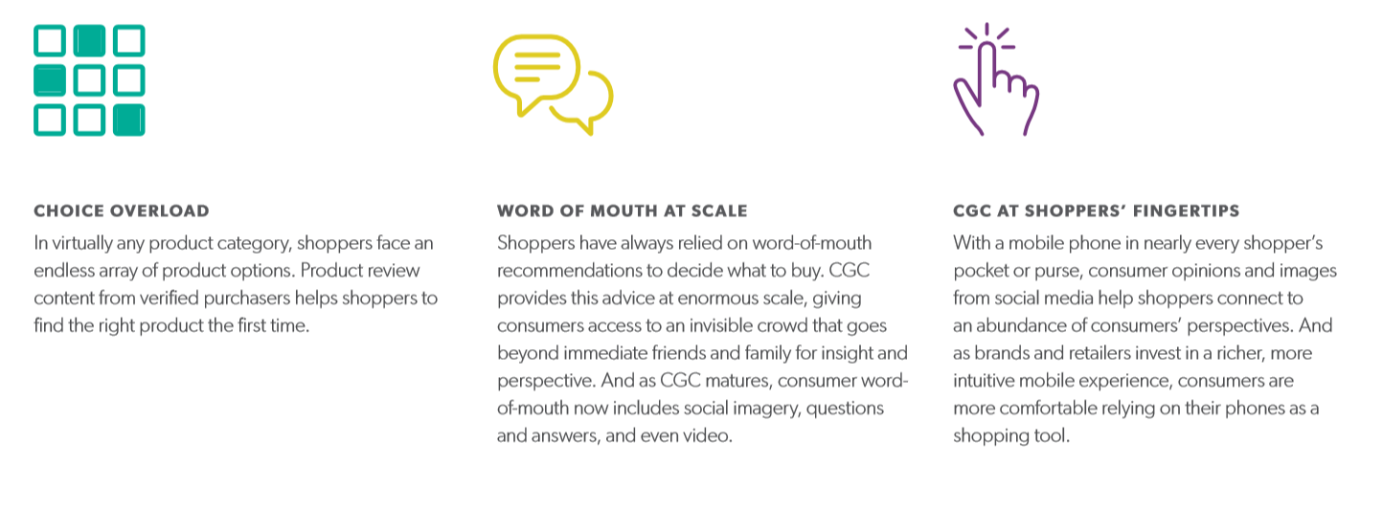
“research online, buy offline” (ROBO)
2017 was the first year that more than 50% of traffic to product pages was on mobile devices, which indicates that even those who do not consider themselves frequent online shoppers still visit product pages to inform their in-store purchase decisions.

Slide 14
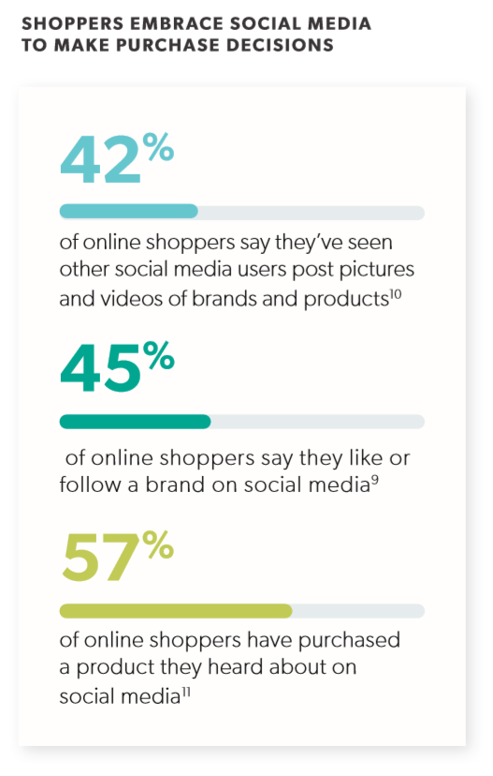
Consumer Generated Content (CGC) matters
Ratings and reviews, Q&A, and social media pictures are critical in e-commerce
56% of shoppers say it is important or very important for retailers to offer CGC

Slide 15
Translation from Trends to “Real World” Applications
What does “experiential” even mean?

Slide 16
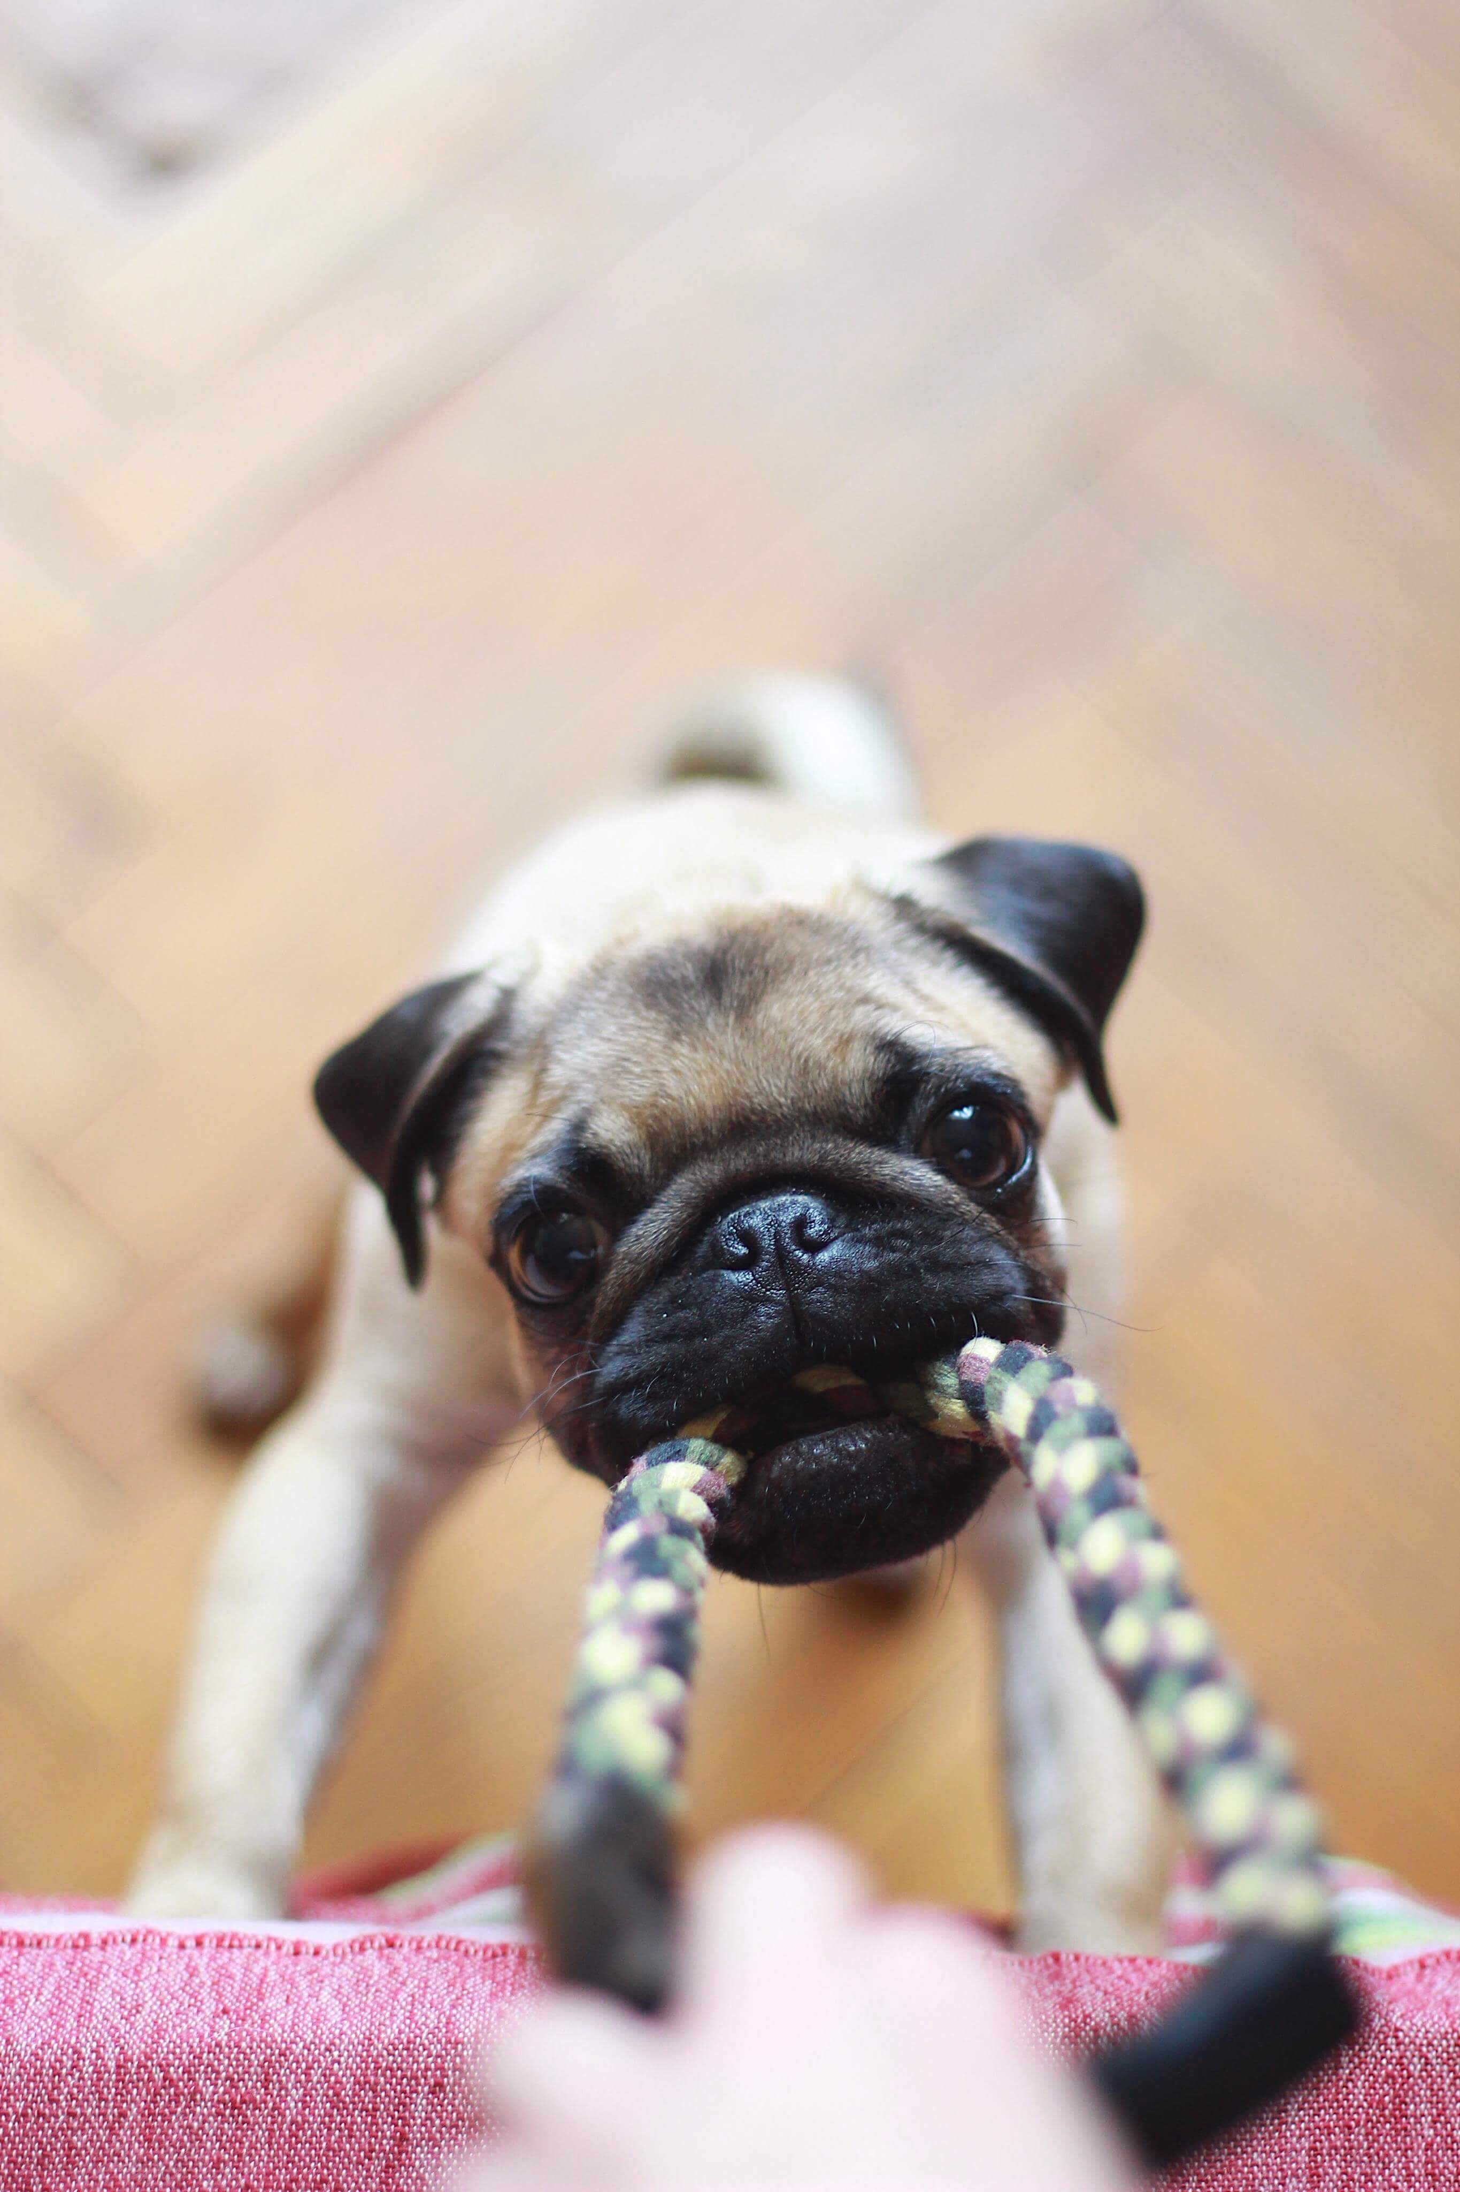
Who are you competing with?
Classify your competition. Experiential moments, can be competitive advantages, but you need to zero in on the right competition to ensure that you’re building the right moments
Lifehack: how to figure out what the hottest selling items are on Amazon? Are you ready for that?
Notes:
I think a SWOT is very useful here. We can use Jak’s as an example. Our system is very different in Canada than States. We compete with the guy who owns the listings, the distribution, pricing and 200 stores that compete directly with us...

Slide 17
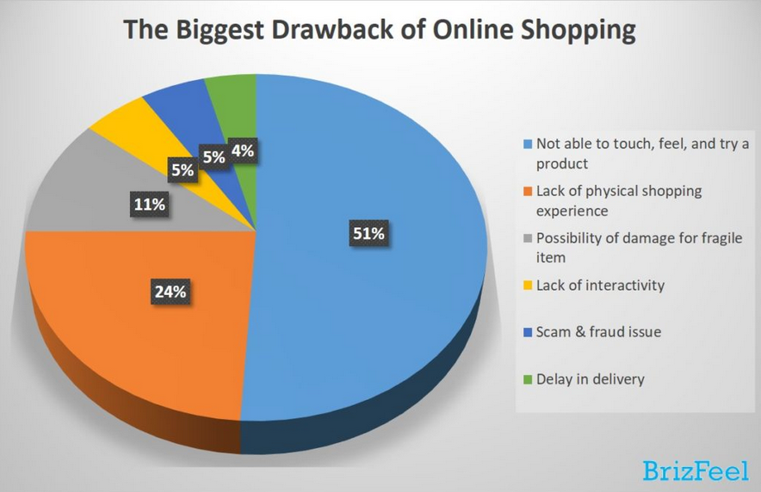
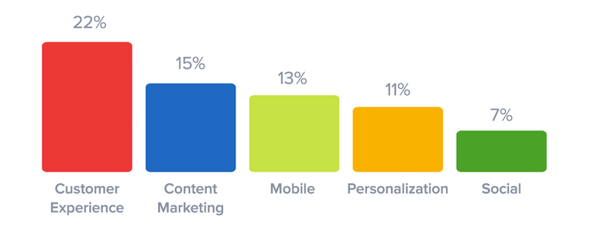
Online vulnerability
Amazon doesn’t know bricks and mortar
Bricks & Mortar can compete with online (online merchandising or online sales)
When Econsultancy conducted their survey for Digital Marketing Trends, they asked companies to state the single most exciting opportunity for 2019. Customer experience came in first.
Lifehack - You can take pictures like Amazon, but show them how much better it is when they get to store. (Full 360 experience)
Use your merchandising experience to win.
https://www.business2community.com/consumer-marketing/25-stats-on-consumer-shopping-trends-for-2019-02175812

Slide 18
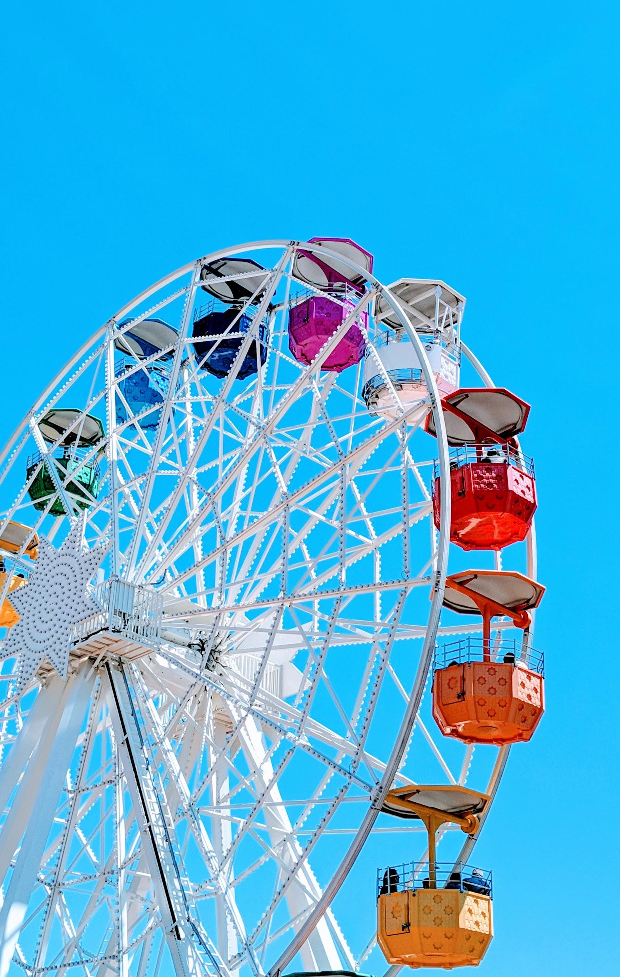
Experiential doesn’t need to be ferris wheel outside your store
You don’t need a carnival in your store everyday.
Every day tactical things that can enrich your customers experience
Notes:
Think about showing how to search - live demo? How to do in Amazon

Slide 19
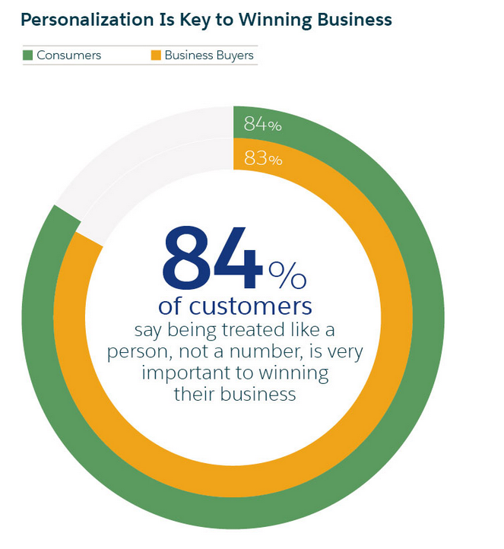
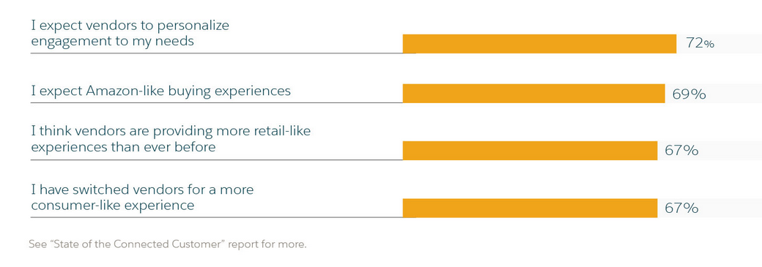
Customers expect your business to listen and respond
According to Salesforce’s 2019 State of the Connected Customer Report, 62% of customers expect companies to adapt based on consumer behavior, and even more pressing, 73% of shoppers expect a brand to understand their needs and expectations

Slide 20
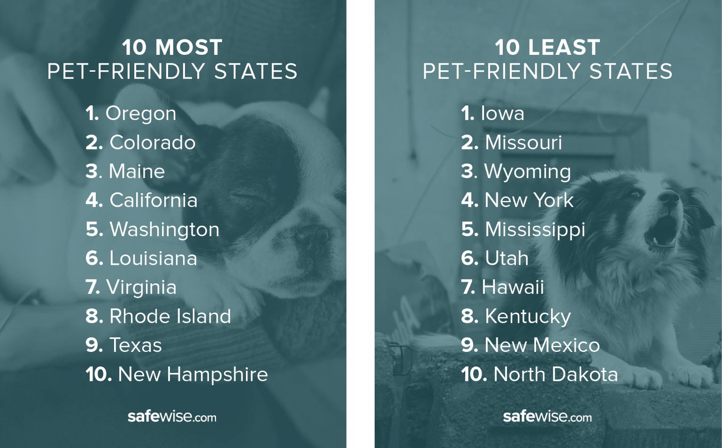
Who are you missing as a partner?
GoPro & Red Bull
Pottery Barn & Sherwin-Williams
Casper & West Elm
Taco Bell & Doritos
Kanye and Adidas
Partnerships can be key. Who is missing from your experience?
Active lifestyle + Energy
Modern Design & DIY
Comfort & Contemporary Fashion
Fast Food & Favorite Snacks
Pop Culture and Cultural Fashion
Notes:
collaborations. ie - retailers who are trying to do too many things. ie your ikea example is a great one, but if a small retailer can't do meals+merchandising+special events - how do you partner with a local artist+local coffee shop/bistro to build an experience that everyone will love
https://blog.hubspot.com/marketing/best-cobranding-partnerships

Slide 21
Building Experiential that means something for retailers
A special moment between a retailer and a customer (what does this look like?)
Capitalizing on the moment (making the purchase happen)
Making the moment shareable
Making the moment repeatable
Notes:
Similar to what I will be discussing - I think if we really bring this right down to basics for these folks. What you are trying to tell your consumer is critical. Your communication must be very simple. Very clear. You must buy into the idea - be convicted. You have believe in yourself and what you are doing - be confident.

Slide 22
